Slide 1

Reinforcement Learning
Comparative Analysis of Q-learning and SARSA
in the Flappy Bird Game
Professor: Jean Martinet
Students: Kha Duy Phan, Huy Dinh Nguyen
Notes:
MSc 2 DATA SCIENCES & ARTIFICIAL INTELLIGENCE

Slide 2
Agenda
Overview​
Q-learning & SARSA
Results
03
09
11
Notes:
My presentation includes:
Introduction,
Academic Journey,
Professional Experience,
Outstanding projects,
Career goals,
Math excersises and approaches.

Slide 3
1. Overview
Notes:
Academic Journey

Slide 4
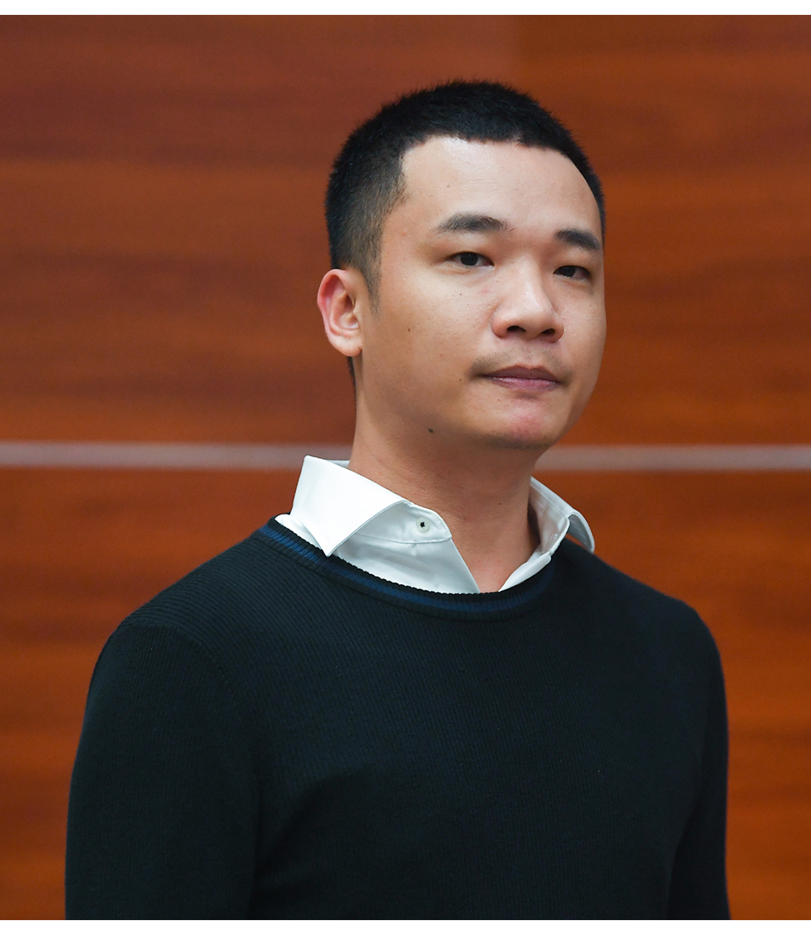
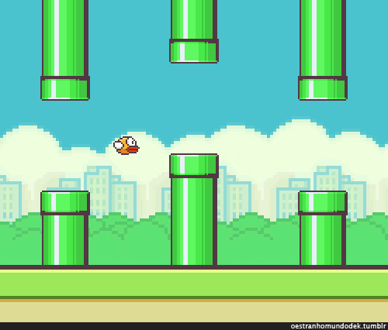
Introduction
Flappy Bird is a 2013 casual mobile game developed by Vietnamese video game artist and programmer Dong Nguyen.
50 million times
5 million daily
$320 million
Flappy Bird is an arcade-style game in which the player controls the bird Faby, which moves persistently to the right. They are tasked with navigating Faby through pairs of pipes that have equally sized gaps placed at random heights. Faby automatically descends and only ascends when the player taps the touchscreen.
Notes:
My name is Huy and everyone can call me Tim,
I graduated in 2023 majoring in Construction Informatics, Faculty of Irrigation Engineering, Da Nang University of Science and Technology,
I have more than 2 years of working experience as FullStack – Data Engineer

Slide 5
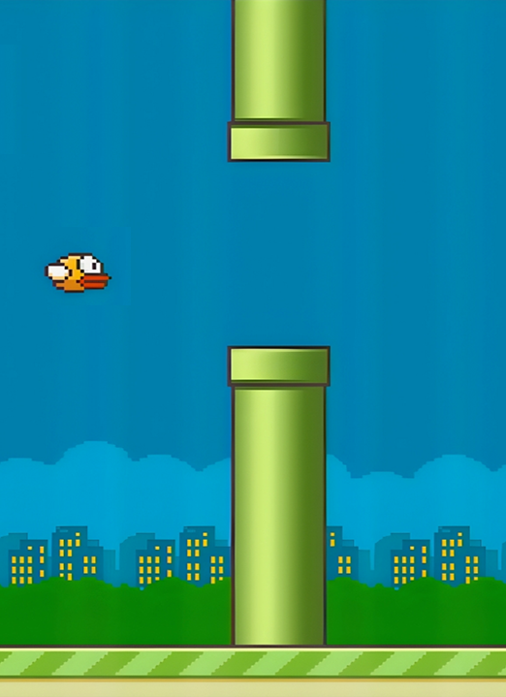
States
0
x_{bird}
x_{pipe}
x_{gift}
x
How do we define a state? Each state is a list that contains:
(x_{pipe}, y_{pipe} – y_{bird}, x_{gift}, y_{gift} – y_{bird})
y_{pipe}
y_{bird}
y_{gift}
y
Notes:
My name is Huy and everyone can call me Tim,
I graduated in 2023 majoring in Construction Informatics, Faculty of Irrigation Engineering, Da Nang University of Science and Technology,
I have more than 2 years of working experience as FullStack – Data Engineer

Slide 6
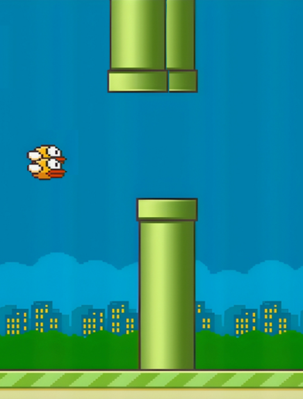

States
Width // 40
How do we define a state? Each state is a list that contains:
(x_{pipe}, y_{pipe} – y_{bird}, x_{gift}, y_{gift} – y_{bird})
Height // 40
How many states? Width // 40, Height // 40
Flap
Action: Flap (move up by velocity), Do nothing (fall by gravity)
Notes:
My name is Huy and everyone can call me Tim,
I graduated in 2023 majoring in Construction Informatics, Faculty of Irrigation Engineering, Da Nang University of Science and Technology,
I have more than 2 years of working experience as FullStack – Data Engineer

Slide 7
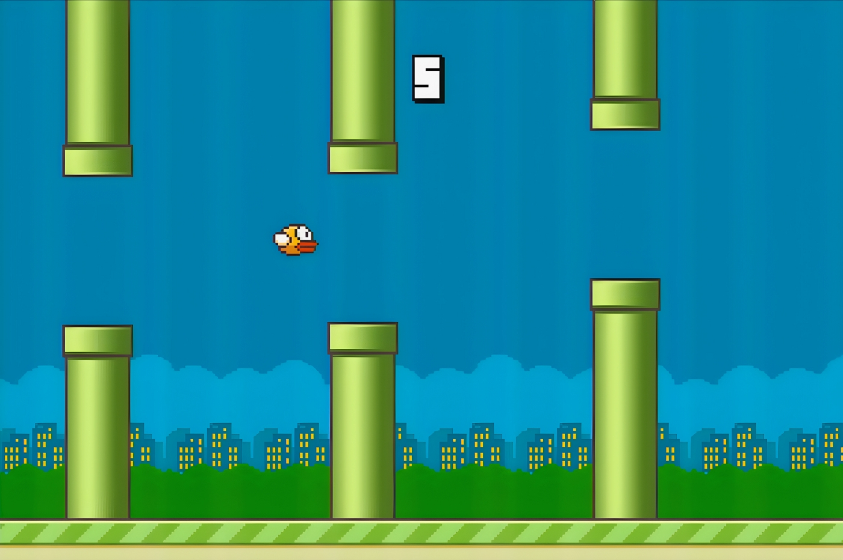

Flap (Move up)
Vertical distance
Gap size
Mechanics
Do nothing (Fall)
Gravity
Gift

Slide 8
Missing a Gift
Reward - 50
Passing a pipe
Score + 1, reward + 200
Collision or Out-of-bounds
Reward – 1000, END
Collecting a Gift
Gift + 1, reward + 500

Slide 9
2. Q-learning and SARSA
Notes:
Academic Journey

Slide 10
Q-learning
SARSA

Slide 11

3. Results
11

Slide 12
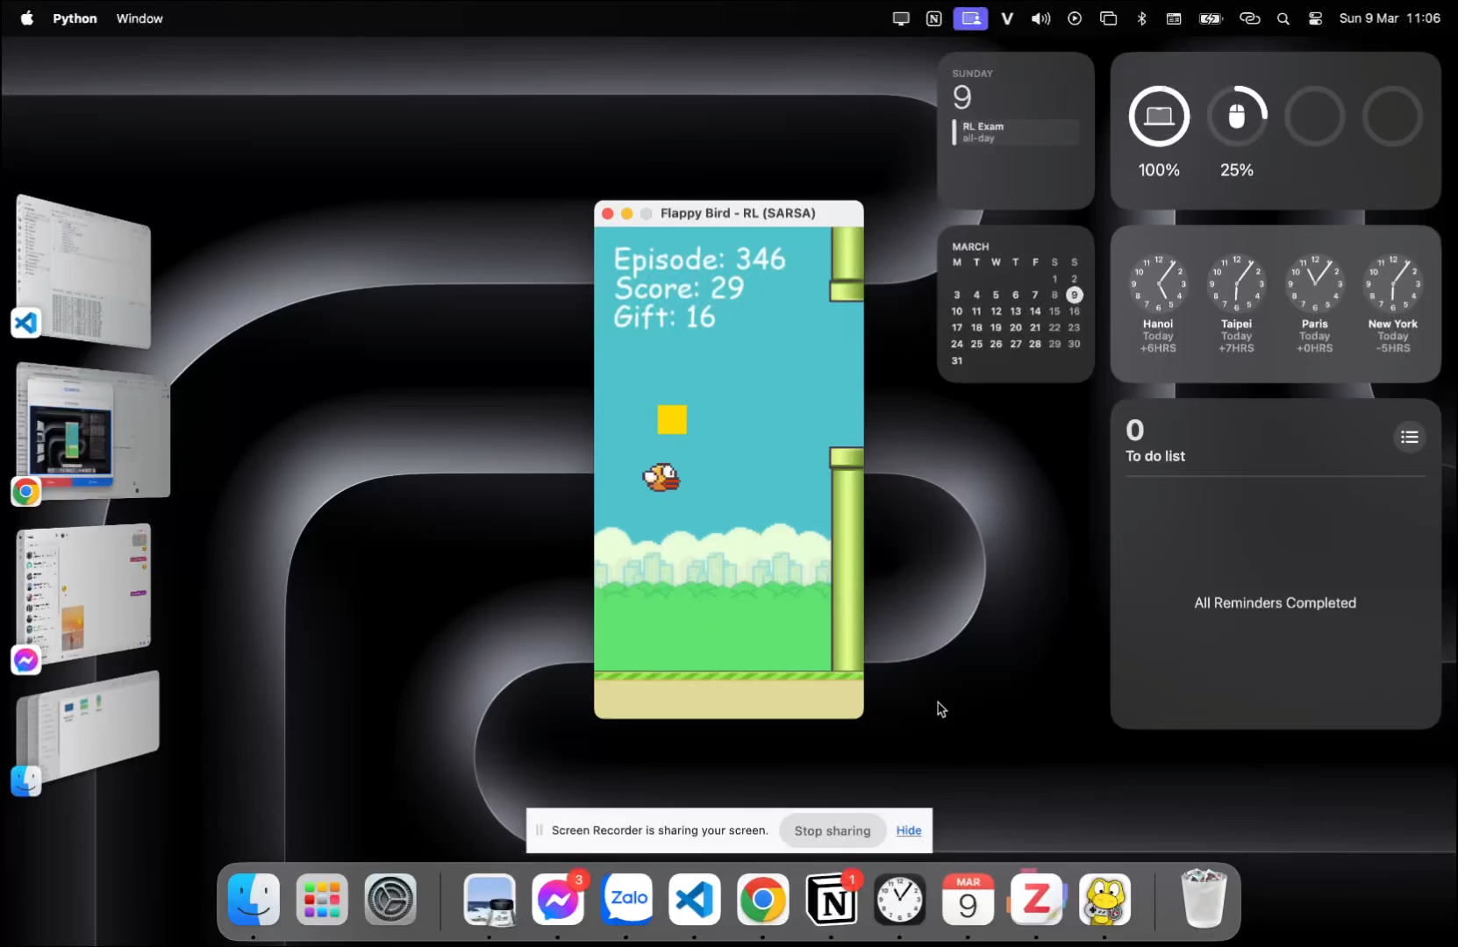
Training
Key parameters include:
Learning rate (α): 0.1.
Discount factor (γ): 0.9
Number of episodes: 800

Slide 13
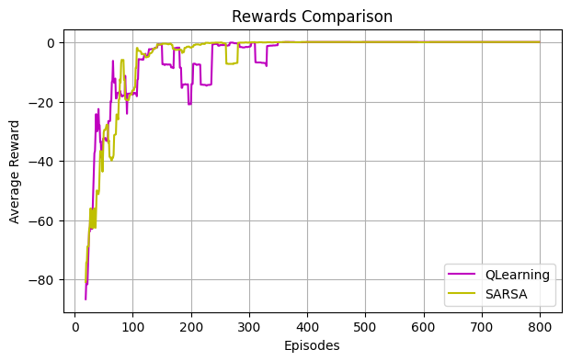
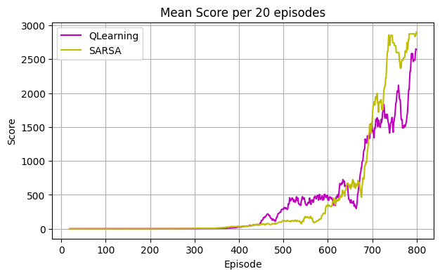
Rewards & Scores

Slide 14
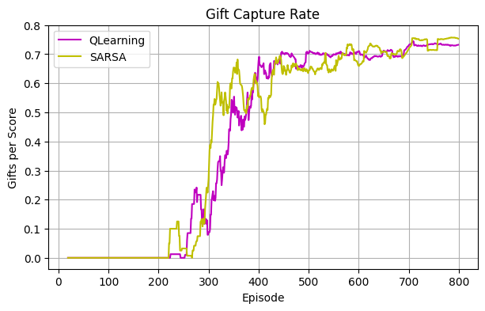
Gift rate

Slide 15
Thanks
15

